Slide 1





Presented By
ZAHID MUSHTAQ
Student at SSM College
Enroll 5513

Slide 2


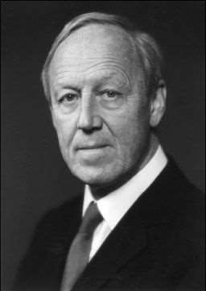
INTRODUCTION
MHD power generation is a direct energy conversion,which converts the Heat Energy directly into Electrical Energy without any intermediate Mechanical Energy conversion.
Magneto Hydro Dynamic (MHD) or Hydro dynamics is the Academic Discipline which studies the Dynamics of Electrically conducting fluids Ex: Plasma, Liquid metals and Salt water
The Word MHD derived from Magneto- Magnetic Field,Hydro-Liquid and Dynamics-Movement
The field of MHD was Proposed by Hannes Alfven for which he received the noble prize in Physics in 1970

Slide 3

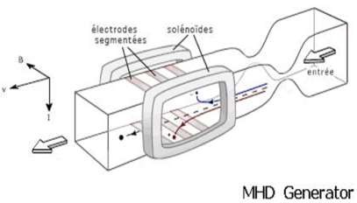
HISTORY OF MHD
It was introduced by Michael Faraday in 1832 in his Bakerian Lecture.
He carried out a experiment at Waterloo Bridge in UK for measuring the current, from the flow of river Thames in Earth’s Magnetic Field.
Over the years then the first MHD-Generator was built in 1959 in USA
The first MHD power Plant was constructed in USSR in 1970

Slide 4

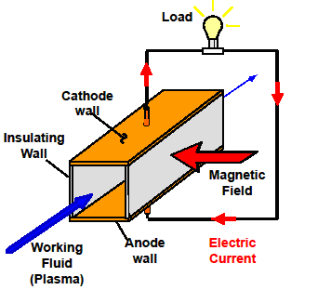
PRINCIPLE
Faraday’s Law of Electromagnetic Induction : When an electric conductor moves across a magnetic field, an emf is induced in it, which produces an electric current .

Slide 5

METHODS OF MHD POWER GENERATION
Open Cycle MHD System
Closed Cycle MHD System 1.Seeded Inert Gas System 2.Liquid Metal System

Slide 6

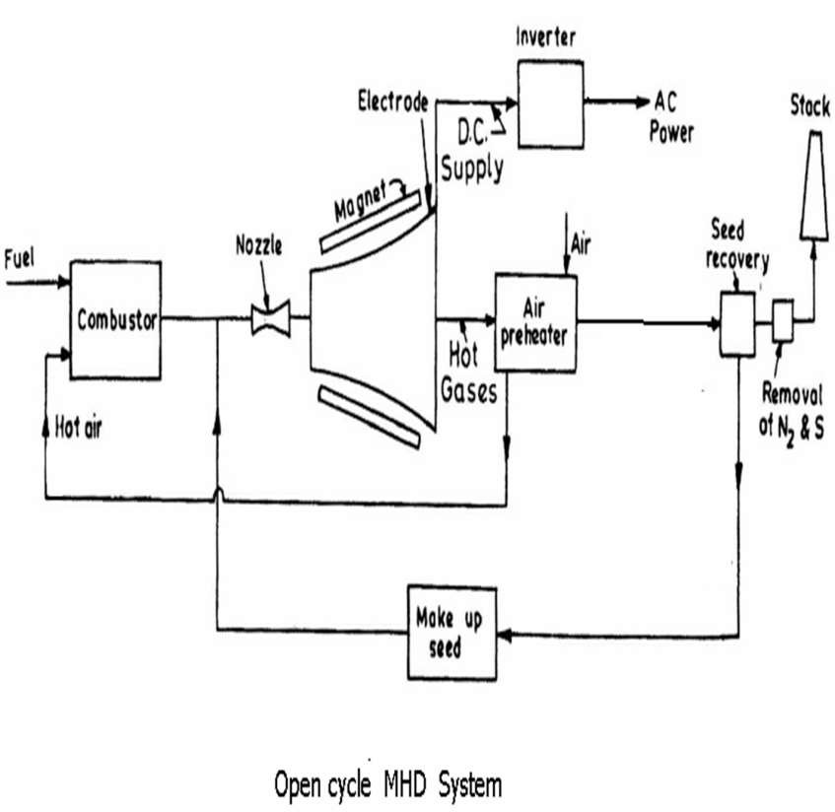
OPEN CYCLE MHD SYSTEM

Slide 7

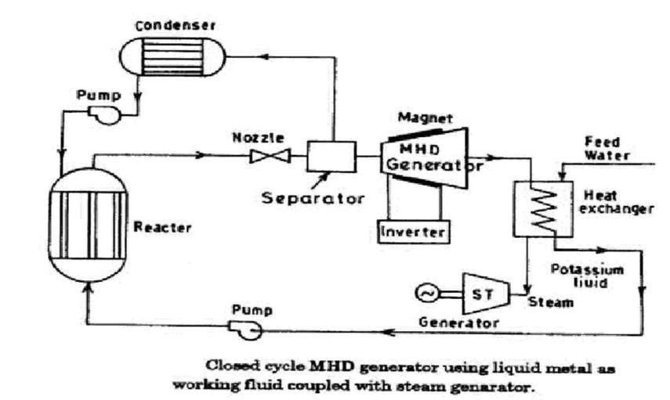
CLOSED CYCLE MHD SYSTEM

Slide 8
DIFFERENCE BETWEEN OPEN AND CLOSED CYCLES
OPEN CYCLE SYSTEM
Working fluid after generating electrical energy is discharged to the atmosphere through a stack.
Operation of MHD generator is done directly on combustion products
Temperature required is about 2300˚C to 2700˚C
More developed
CLOSED CYCLE SYSTEM
Working fluid is recycled to the heat sources and thus is used again
Helium or Argon(with Cesium Seeding) is used as the working fluid.
Temperature required is about 530˚C
Less developed

Slide 9

ADVANTAGES
No moving parts, so no mechanical losses.
Overall Efficiency is about 50%.
Large Amount of pollution free power is generated.
Size of Plant is small compared to other Fossil fuel plants.
Less overall generation cost.

Slide 10

DISADVANTAGES
Very Large Magnets are needed, this is the major expense.
High Friction and Heat Transfer losses.
High operating temperature.
Even though overall generation cost is less ,DC to AC Converters increase the cost of plant.

Slide 11

CONCLUSION
MHD Power Generation is a Direct Energy conversion system, which converts Heat Energy into Electrical Energy .By this generation technique large power is generated without pollution.

